Slide 1

New Features
TTF- Week 3

Slide 2
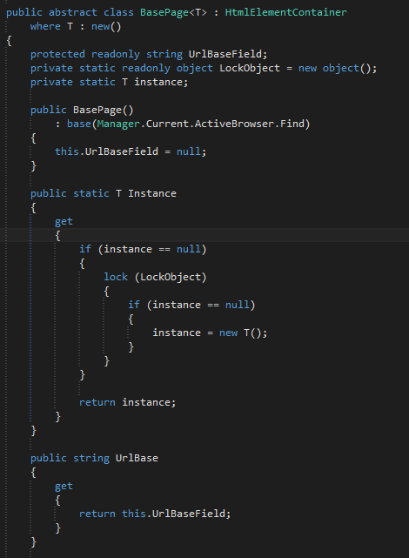
Singleton for Pages

Slide 3
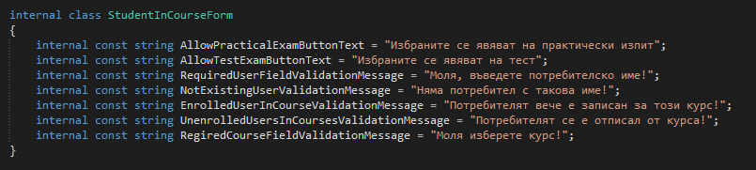
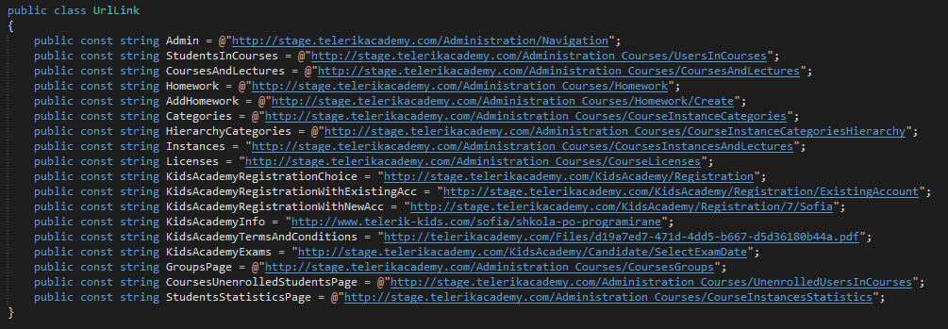
Classes for constants
Slide Content

Slide 4
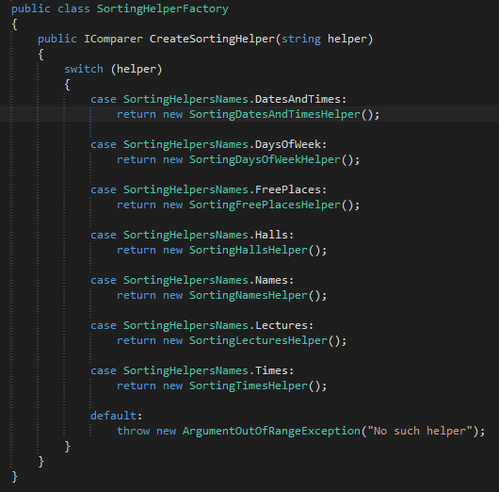
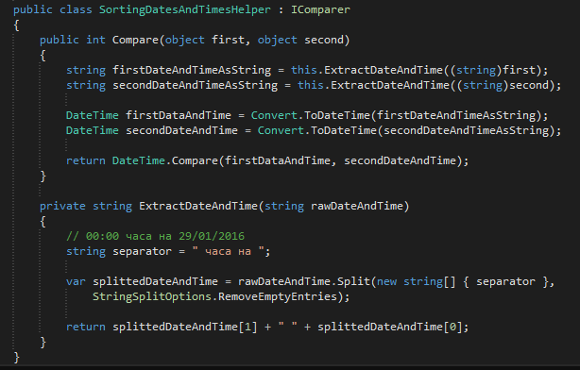
Factory for sorting
Slide Content

Slide 5
Thank you

